Slide 1
Virtual Cluster over OpenNebula
(Progress Report)
Pongsakorn U-chupala
26/07/2011

Slide 2
Agenda
OpenNebula Installation
Progress
Issues & Problems

Slide 3

1. OpenNebula Installation

Slide 4
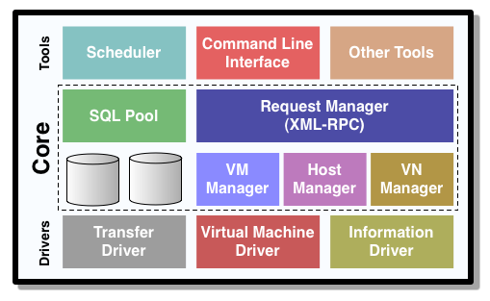
Architecture (1/3)
Internal

Slide 5
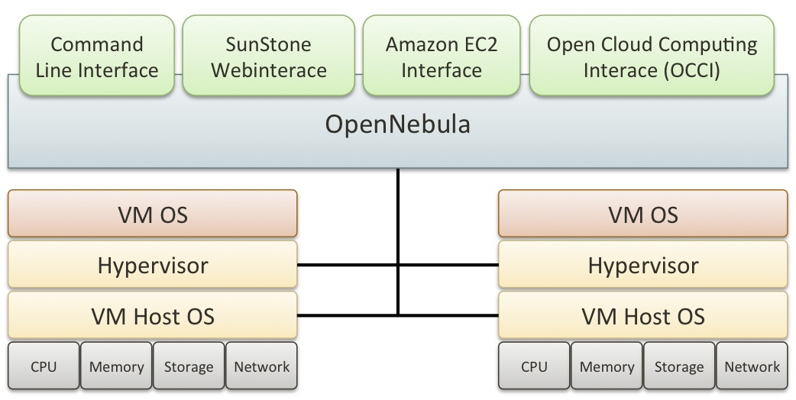
Architecture (2/3)
External

Slide 6
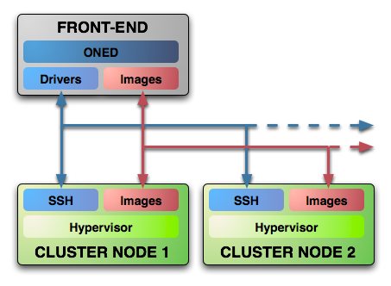
Architecture (3/3)
Installation
Notes:
To put it simply ...
- ONED is OpenNebula Daemon

Slide 7
Architecture
External

Slide 8
My Installation (1/2)
Rocks Cluster
Public Network
Frontend
OpenNebula
NFS Server
Xen
Private Network
VM-Container-0-0
VM-Container-0-1
Xen
Xen

Slide 9
My Installation (2/2)
CLI / Web Interface / Others
Frontend
OpenNebula
NFS Server
Xen
SSH (oneadmin)
Mount
VM-Container-0-0
VM-Container-0-1
Xen
Xen

Slide 10
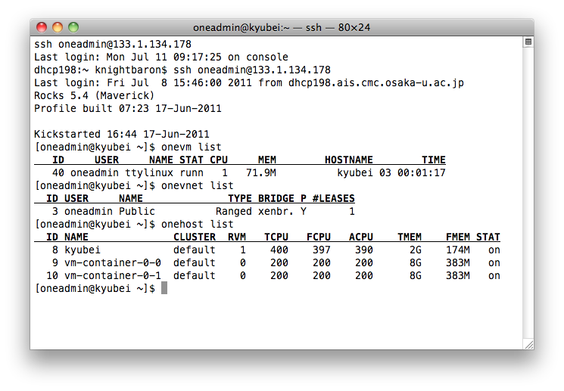
Command-line Interface

Slide 11
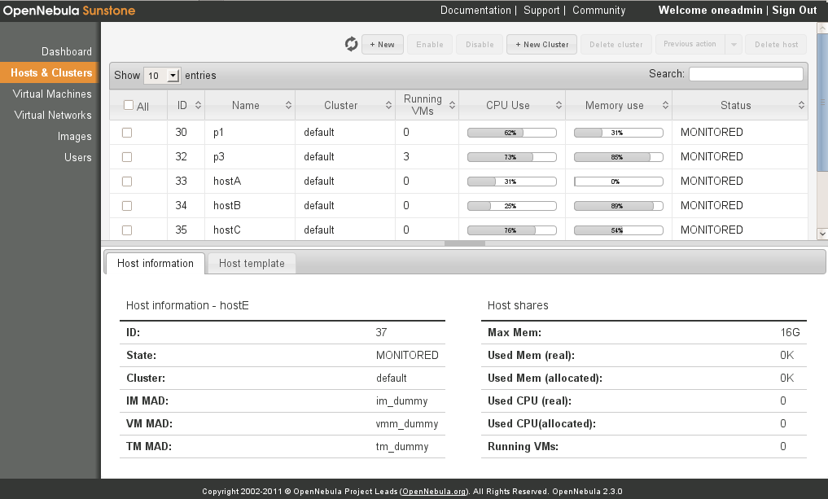
Web Interface
OpenNebula Sunstone

Slide 12

2. Progress

Slide 13
What I have done
Booted OpenNebula sample image (ttylinux) in Fully Virtualized mode with networking
Researched on how OpenNebula handle Networking and Virtual Network
Found a way to create OS image for OpenNebula
Created OpenNebula-compatible CentOS (OS) image
  Haven’t successfully booted it yet so I can’t verify the result

Slide 14
Current Setup
133.1.134.178
Frontend
ttylinux
10.1.1.1
10.1.1.129 (Bridged)
10.1.1.0/8
10.1.255.254
10.1.255.253
VM-Container-0-0
VM-Container-0-1
Notes:
There’s a utility called “onevnet” but I’m not sure if it can automatically create virtual network for me or not.

Slide 15
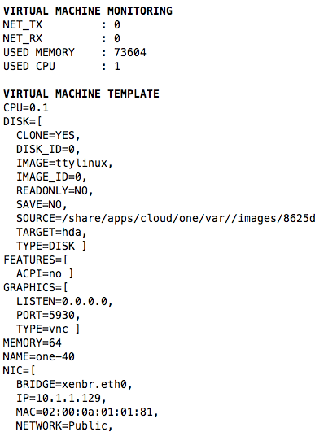
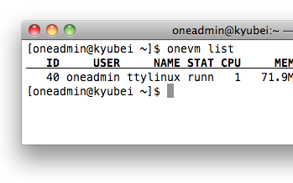
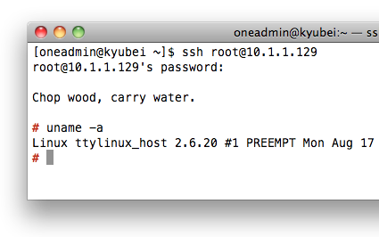

Slide 16
What I have been doing
Try to boot CentOS with OpenNebula
  Tweaking configurations
Notes:
OS image is a type of image in OpenNebula

Slide 17
What I am going to do
Connecting multiple VMs together in the same virtual network
  Start with multiple VMs in the same machine
  Then in the same cluster
For cross-site virtual network, I may need to manually set up overlay network

Slide 18
What I am planning to do
  Install Rocks Cluster in Fully-virtualized mode

Slide 19

3. Issues & Problems

Slide 20
Problems
Automatic VNC port generation of OpenNebula doesn’t play well with Xen
  At least, VNC is working so I’ll leave it at that that for now
2 out of 3 machines in my testbed do not support CPU Virtualization
  Can work only in Para-virtualized mode
  I’ll use Bevis’ machines after he finish with his work
1 machine that worked have only 2 GB of RAM
  Extra RAM given to me by Ichikawa-sensei isn’t work :-(
Notes:
Not to mention that it’s also act as a frontend. not really enough to hold virtual machines.

Slide 21
Issues
Not many documentation on how to use OpenNebula with Xen.
Not many OpenNebula user to talk to
Kind of busy with exam an trip preparation
  All exams will be finished by this Thursday (7/28)
Lab trip (8/11 - 8/12) overlap with Comic Market (8/12 - 8/14) :-(

Slide 22
Conclusion
OpenNebula Installation
Progress
Issues & Problems

Slide 23
Questions?

Slide 24
My Questions

Slide 25
ありがとうございました

Slide 26
References
http://opennebula.org/

